Slide 1
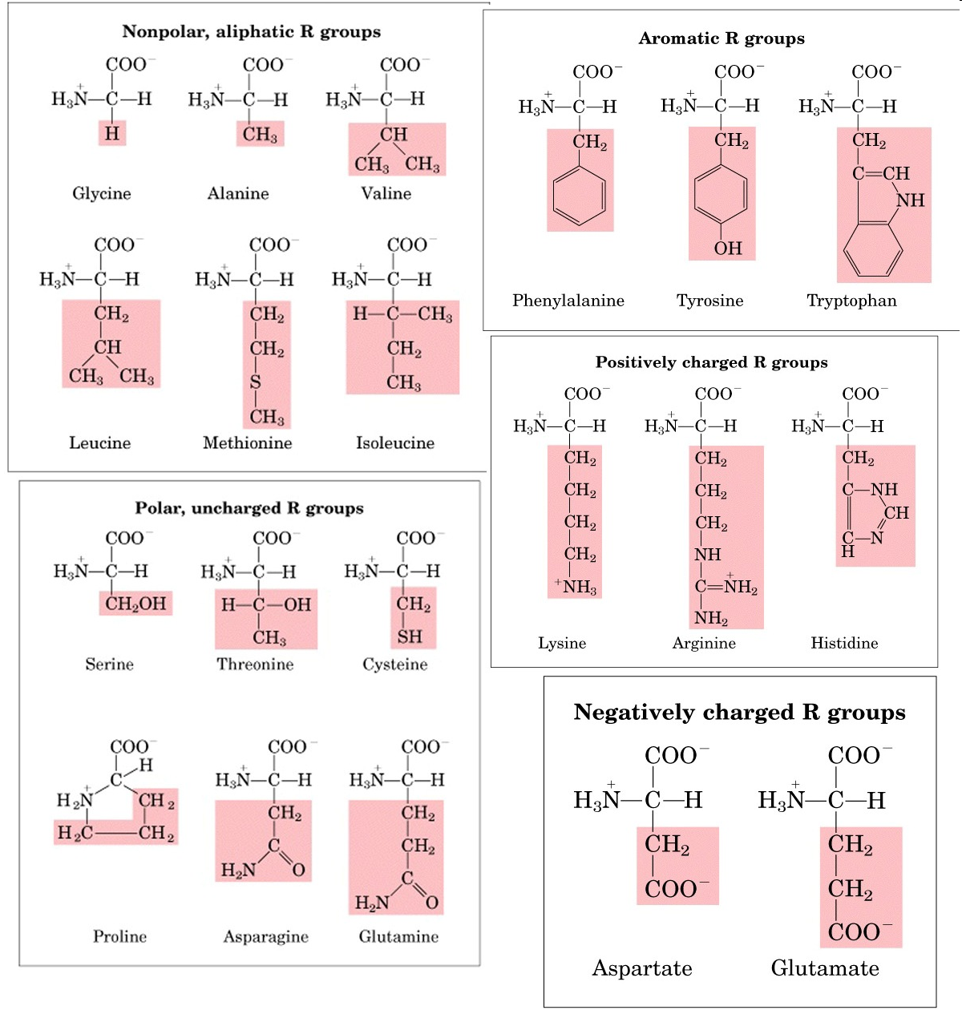
Amino acids
:
Introduction to Proteins: Structure, Function, & Motion
https://amit1b.wordpress.com/the-molecules-of-life/about/amino-acids/

Slide 2
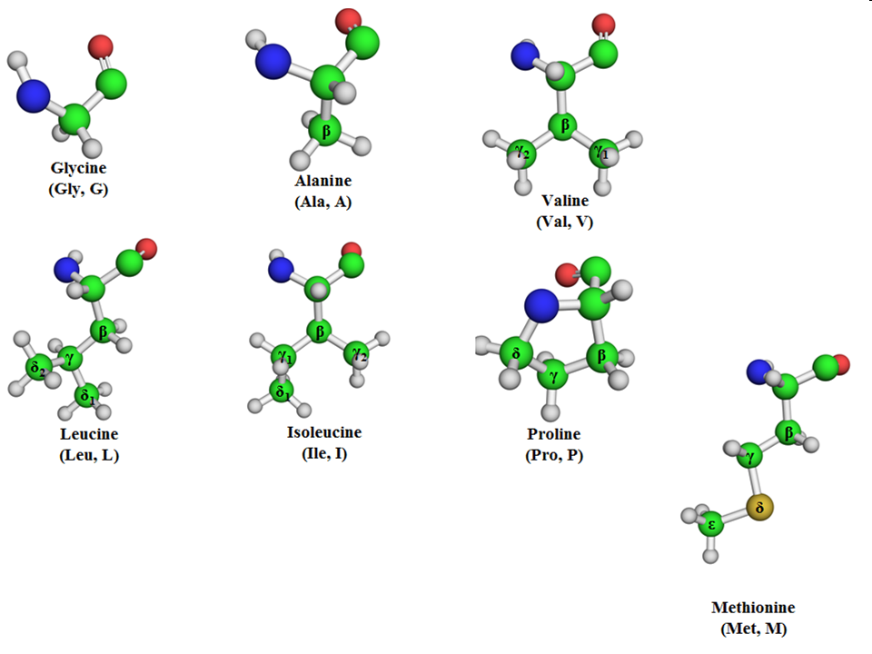
Nonpolar aminoacids
In water-soluble proteins, nonpolar amino acids reside mainly in the hydrophobic core. There, their interactions with each other (the ‘hydrophobic effect‘) is what holds together the 3-dimensional fold of the protein. In membrane-bound proteins, nonpolar amino acids reside on the surface, where they can interact favorably with membrane lipids. Finally, nonpolar interactions involving these amino acids serve as a driving force for the binding of ligands and substrates to the protein.
Here are some interesting facts on some of the nonpolar amino acids:
  Methionine, despite being overall nonpolar, is still able to interact weakly with polar species, such as metals. This is thanks to the non-bonding electrons of methionine’s sulfur atom, which are only weakly held by the nucleus.
  Glycine, having only hydrogen as side chain, confers flexibility to the protein areas in which it is present.
  Proline does the opposite (confers rigidity) due to its side chain being fused to the rest of the amino acid.

Slide 3
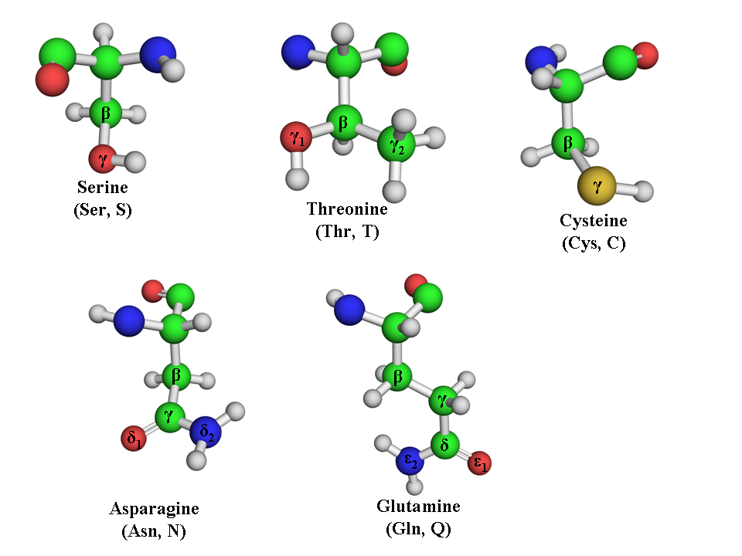
Polar-uncharged amino acids
OH-gruppe
NH₂-gruppe
In proteins, polar-uncharged amino acids form hydrogen bonds with each other and with the protein’s ligand/substrate. This confers specificity to protein-ligand interactions, in contrast to the hydrophobic effect which confers stability and serves as a driving force for the interactions. Some of the polar-uncharged amino acids also function as nucleophiles in enzymatic catalysis.
Here are interesting facts on some polar-uncharged amino acids:
  Serine and threonine are often phosphorylated in proteins that participate in cell-cell communication. This modification is reversible and serves as a chemcial, signal transduction tag. The two amino acids may also function as nucleophiles in enzymatic catalysis, thanks to the hydroxyl group in their side chain.
  Serine and threonine on the surface of membrane/secreted proteins may also be glycosylated (attached with sugar groups). This protects the protein and increases its water solubility. In some cases, the attached sugar groups serve also as a recognition code for other extra-cellular elements.
  Cysteine, despite being polar, tends to appear in core of water-soluble proteins. Under oxidizing conditions, its thiol side chain deprotonates and tends to form a (covalent) disulfide bond with a thiol group of a neighboring cysteine. These bonds are important for stabilizing proteins that are secreted from cells (hormones, antibodies, some enzymes). Cysteine also serves as a nucleophile and an electron-transfer agent in enzymatic catalysis. Both are the result of the non-bonding electrons of cysteine’s sulfur atom, conferring it high chemical reactivity and the ability to exist in different oxidation states.
  The carboxamide group of glutamine and asparagine can serve as both hydrogen bond donor and acceptor. As a result, these amino acids are commonly involved in hydrogen bond networks within proteins. This group in asparagine is also glycosylated in membrane/secreted proteins (see above for the benfits of glycosylation).

Slide 4
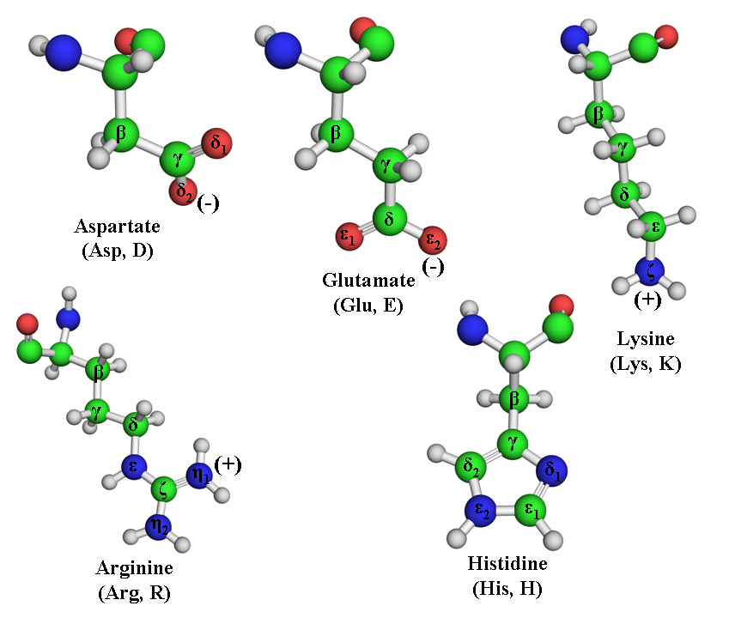
Polar-charged amino acids
COO⁻-gruppe
NH₂⁺-gruppe
Here are interesting facts on some polar-uncharged amino acids:
  Carboxylation of glutamate on its γ carbon (see Fig. 6 below) allows it to bind efficiently cations, such as divalent calcium. This is very useful in clotting proteins, such as prothrombin, the activity of which is regulated by blood calcium levels.
  The amino group of lysine’s side chain is able to form Schiff base with aldehydes. This helps some proteins bind aldehyde-containing prosthetic groups (e.g. the pyridoxal phosphate coenzyme of aminotranferase enzyme).
  Oxidation of lysine’s side chain in structureal proteins like collagen allows it to participate in cross-linking reactions that stabilize these proteins.
  As explained above, the imidazole side chain of histidine can serve as both acid and base thanks to its pKa, which is close to the physiological pH. This is important, for example, for the catalytic mechanism of the enzyme acetylcholine esterase, which inactivates the neurotransmitter acetylcholine. The inactivation is important for preventing our nervous system from going into paralysis and death, which is what happens when the enzyme is attacked and inactivated by toxic nerve agents. Acetylcholine is an ester, and it is hydrolyzed to choline and acetate by the enzyme, via nucleophilic attack of a catalytic serine residue on the ester bond. To do that, the serine must deprotonate, and this is made possible by a nearby histidine which acts as a base, abstracting serine’s proton:
Note that lysine’s side chain has three methylene groups, so that even though the terminal amino group will be charged under physiological conditions, the side chain does have significant hydrophobic character. Lysines are often found buried with only theεamino group exposed to solvent.

Slide 5
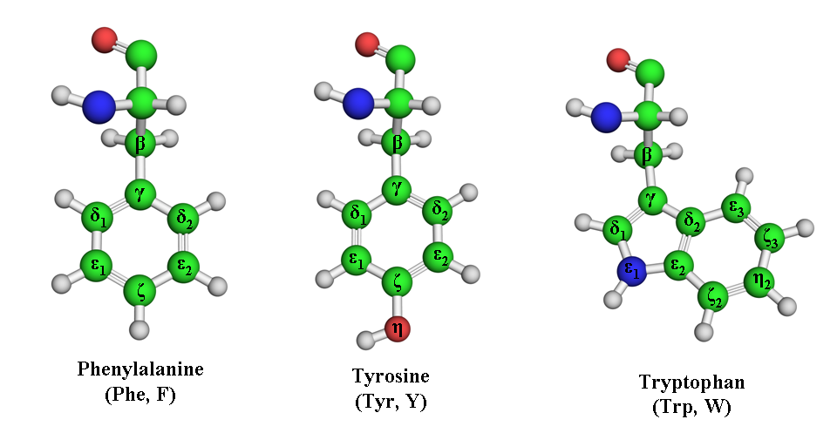
Aromatic amino acids
In contrast to the other amino acids groups, this one is considered not according the polarity of the side chain but rather on its aromatic nature. Aromatic groups contain delocalized π electrons which can interact with similar electrons in other aromatic groups, as well as with positively-charged groups. Indeed, all of these interactions are observed in proteins between aromatic side chains. The aromatic amino acids are important in forming closed scaffolds within proteins, especially binding sites for ligands and substrates.
Here are interesting facts on some aromatic amino acids:
  Like serine and threonine, tyrosine may also become phosphorylated on proteins involved in cellular communications. A well-known example is the membrane-bound receptors which respond to growth factors. Binding of the latter to these receptors results in their phosphorylation, which in turn conveys the signal into the cell and results in cellular division. Genetic defects that allows for hormone-independent phosphoryaltion of these proteins often lead to cancer.
  The phenol group of tyrosine also participates in different mechanisms of enzymatic catalysis (e.g. nucleophilic attack, acid-base catalysis and stabilization of reaction intermediates).
  The indole group in tryptophan’s side chain is capable of participating in different polar and nonpolar non-covalent interactions with other chemical species. Therefore, it is common in protein binding sites. It also participates in enzymatic catalysis and electron transfer.
  Tryptophan’s side chain fluoresce when absorbing UV light. This allows biochemists to identify proteins or study changes in their structure by UV-irradiating them and then recording the fluorescence of their tryptophan amino acids.

Slide 6
